Slide 1

104010 : BASIC ELECTRONICS ENGINEERING UNIT III DIGITAL ELECTRONICS Flip Flops

Slide 2
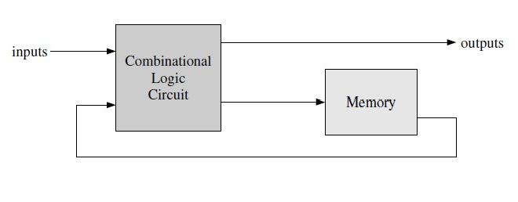
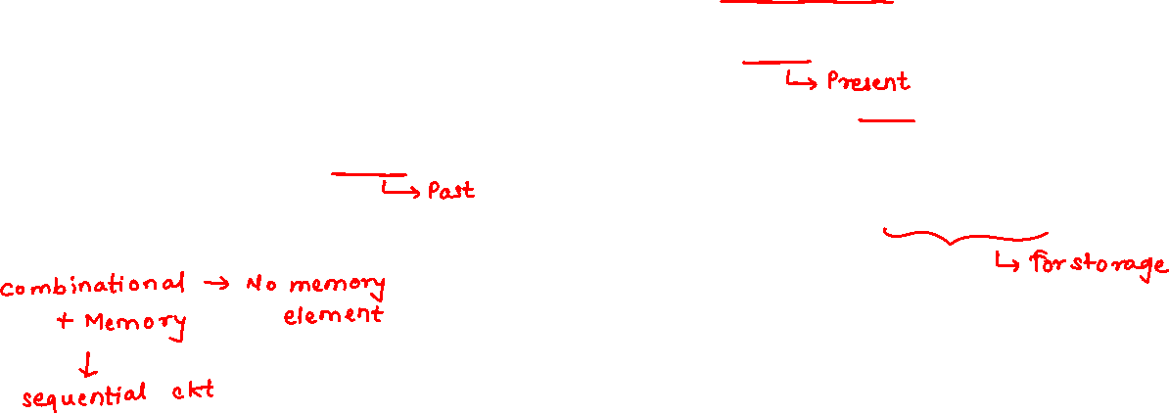
Sequential Circuits
The logic circuits discussed previously are known as combinational.
In that the output depends only on the condition of the latest inputs.
In another type of circuits, the output depends not only on the latest inputs, but also on the condition of earlier inputs.
These circuits are known as sequential, and implicitly they contain memory elements.

Slide 3

Sequential Circuits
A sequential logic circuit must “remember” the past history of the inputs.
It does this using basic memory elements:
Latches
Flip Flops

Slide 4
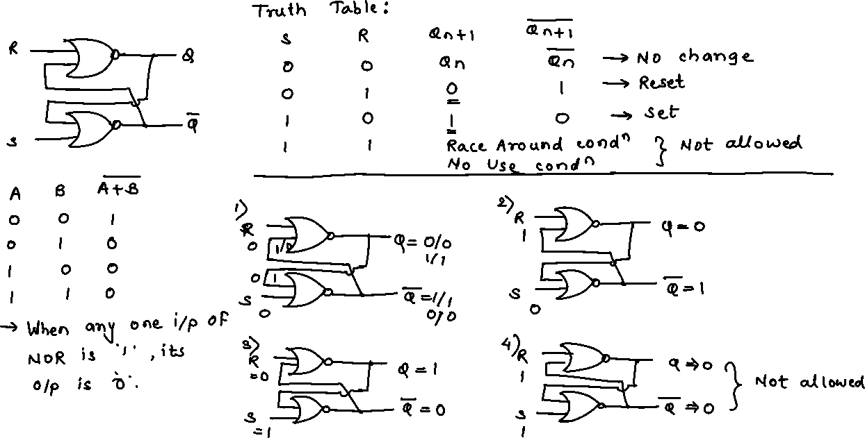

Slide 5
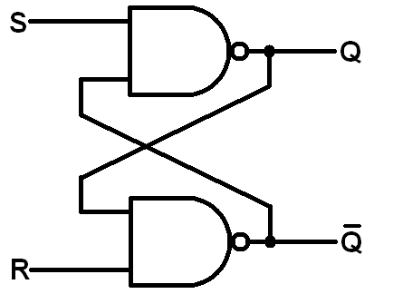
S-R Latch
Implementation of S-R latch using NAND gates and truth table:

Slide 6
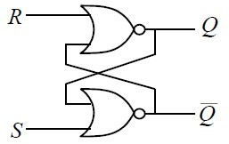
S-R Flip Flop
Set, Reset Flip flop
Set means the output is set to logic ‘1’
Reset Means the output is reset to logic ‘0’
NOR Gate logic: Output is always logic ‘0’ if any one of the inputs is ‘1’ irrespective of the other input
NAND Gate Logic: Output is always logic ‘1’ if any one of the inputs is ‘0’ irrespective of the other input
NOR GATE LOGIC
A | B | Y
0 | 0 | 1
0 | 1 | 0
1 | 0 | 0
1 | 1 | 0

Slide 7
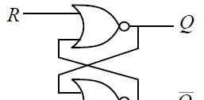
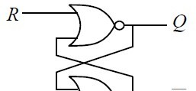


S-R Flip Flop
0
1
0
0
0
1
1
0
0
0
0
1
R | S | Q | Q
0 | 0 | No Change
R | S | Q | Q
0 | 0 | No Change

Slide 8
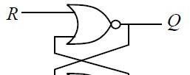


S-R Flip Flop
Consider R=1 and S=0
■ In this case, R=1, the output of the upper NOR gate becomes ‘0’ irrespective of the other input,
i.e Q=0
S=0, Q=0 implies, the output of the lower NOR gate Q = 1
This condition is called no change condition
This state Resets the output to zero ‘0’
■
1
0
0
0
1
R S Q
1 0 0
Q
1

Slide 9
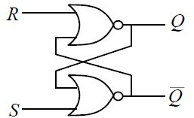
S-R Flip Flop
Consider R=0 and S=1
■ In this case, S=1, the output of the lower NOR gate becomes
‘0’ irrespective of the other input,
i.e Q = 0
1
■
0
0
■ R=0 and Q = 0 , implies the
1
0
output of the upper NOR gate is ‘1’
■ This state Sets the output Q to zero ‘1’
R S Q
0 1 1
Q
0

Slide 10
S-R Flip Flop
Consider R=1 and S=1
In this case, one of the inputs of the both NOR gates is ‘1’, both the outputs try to become zero
This state is not acceptable, not used
0
1
0
0
1
0
R S Q
Q
1
1
No Use Race

Slide 11
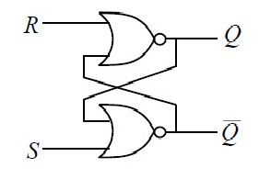
S-R Flip Flop
R | S | Q
0 | 0 | No Change
0 | 1 | 1
1 | 0 | 0
1 | 1 | No Use Race
■ It is a latch, since it changes when ever the input changes, no control of clock

Slide 12
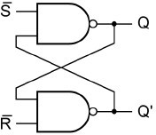
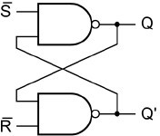
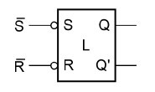
S-R Flip Flop Using NAND Gates
1
0
1
1
0
0
0
0
1
1
1
0
Symbol

Slide 13
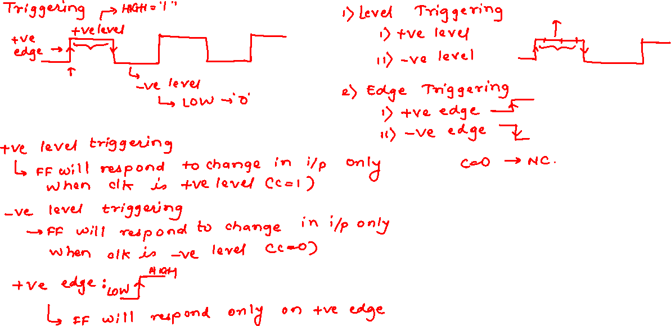

Slide 14
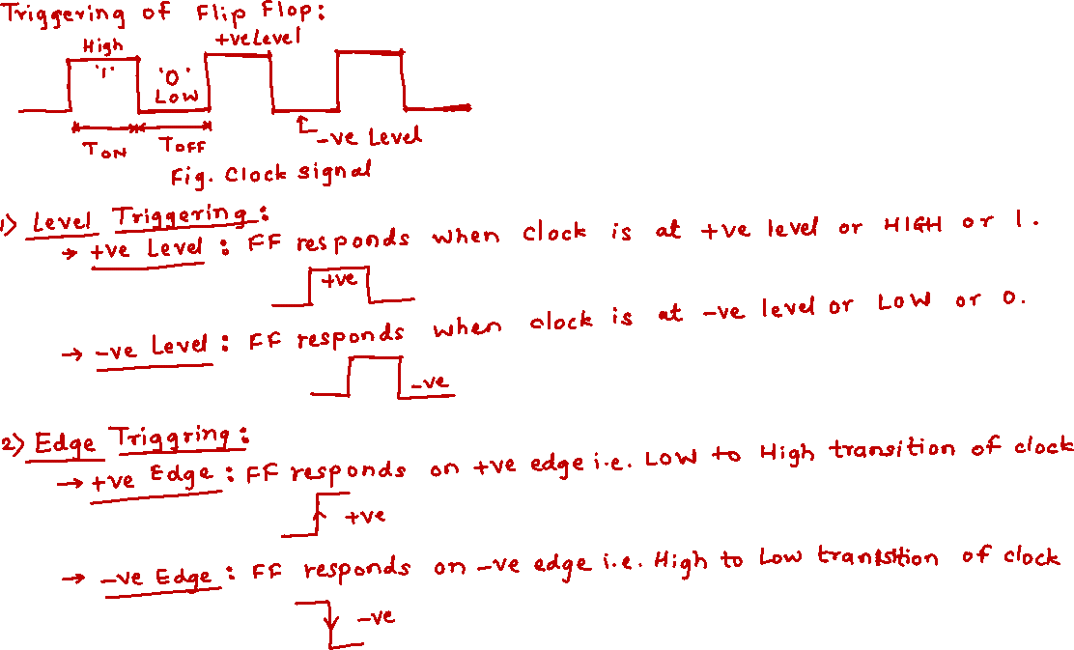

Slide 15
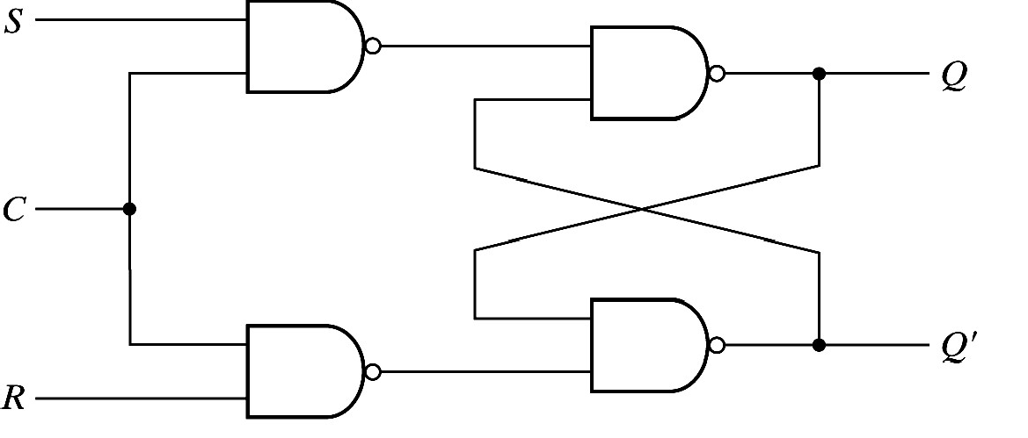



S-R Flip Flop with Control Input (Clock)
C S R Q
0
1
1
1
1
X 0
0
1
1
X 0
1
0
1
No Change No Change 0
1
No Use Race

Slide 16
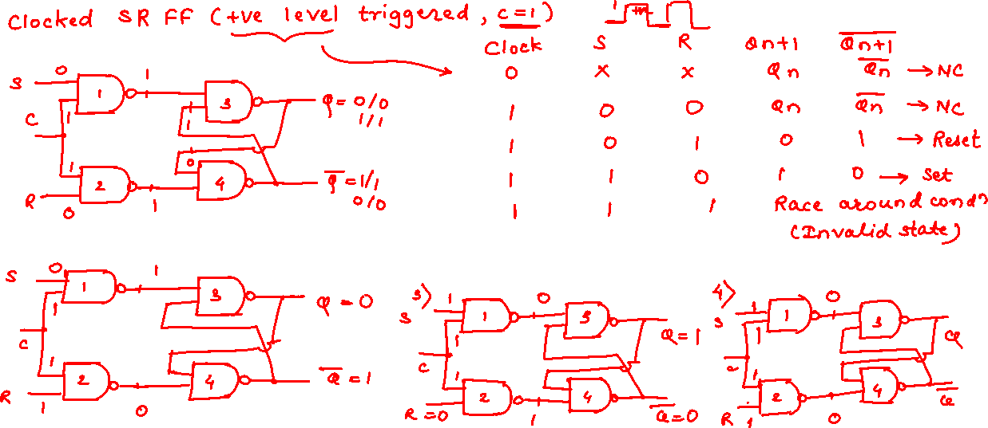

Slide 17
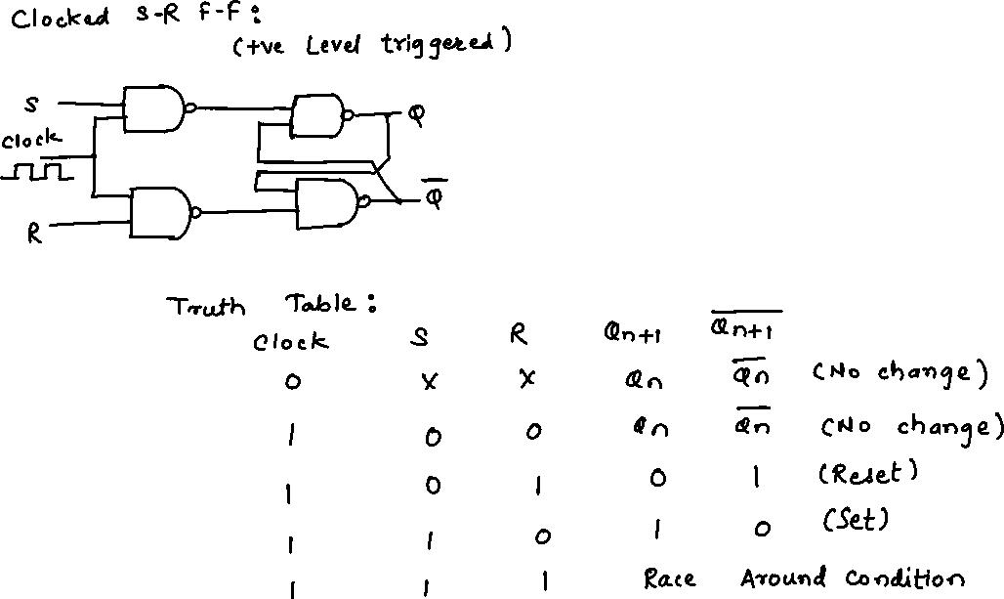

Slide 18
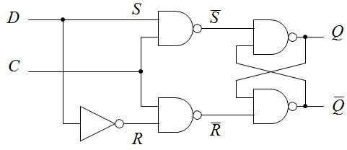
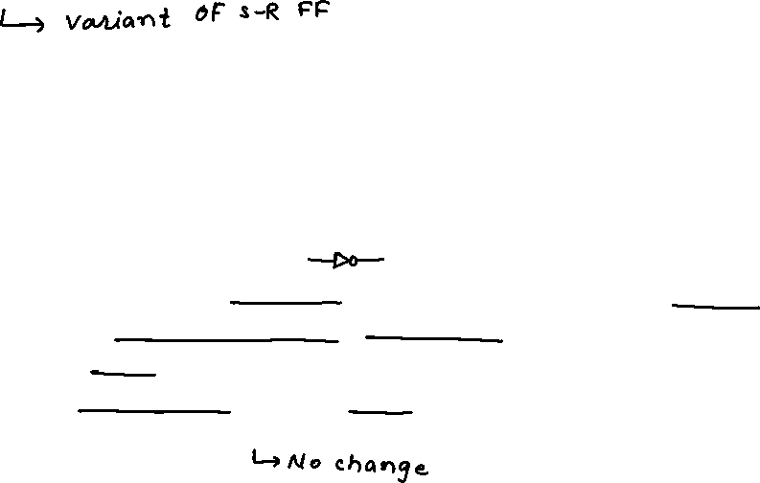
D Flip Flop
C | D | Q
0 | X | No Change
1 | 0 | 0
1 | 1 | 1
The problem with S = R = 1 can be avoided using a common input D.
It is a variant of the more basic S-R flip-flop (Set-Reset).
The output of the latch,
Follows the D input while C = 1 (transparent)
Holds its value while C = 0 (Q = last Q when C went low) no matter what happens at the input
This circuit is often called a transparent latch.

Slide 19
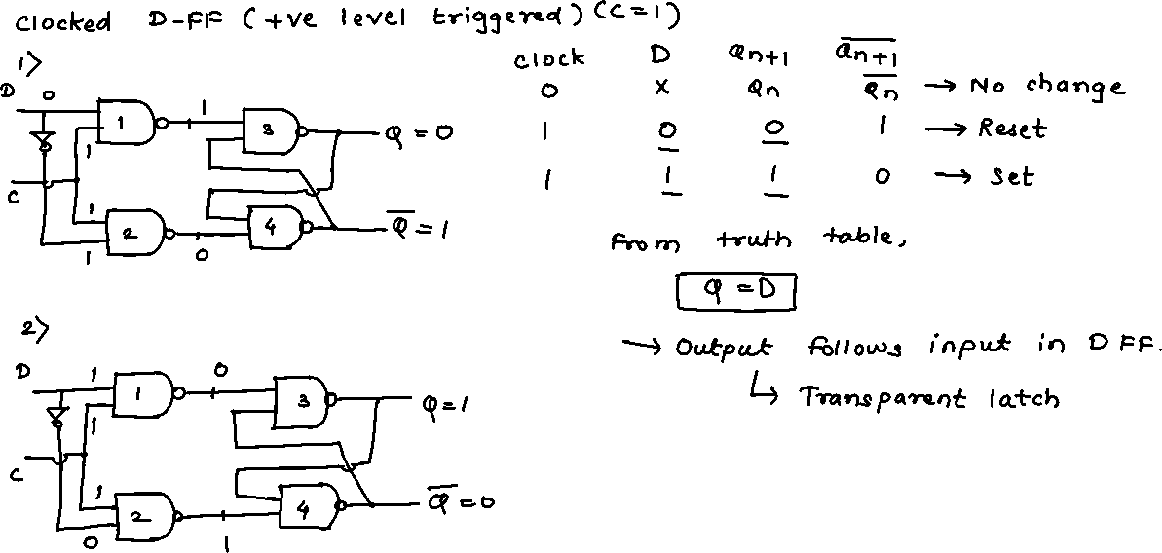

Slide 20
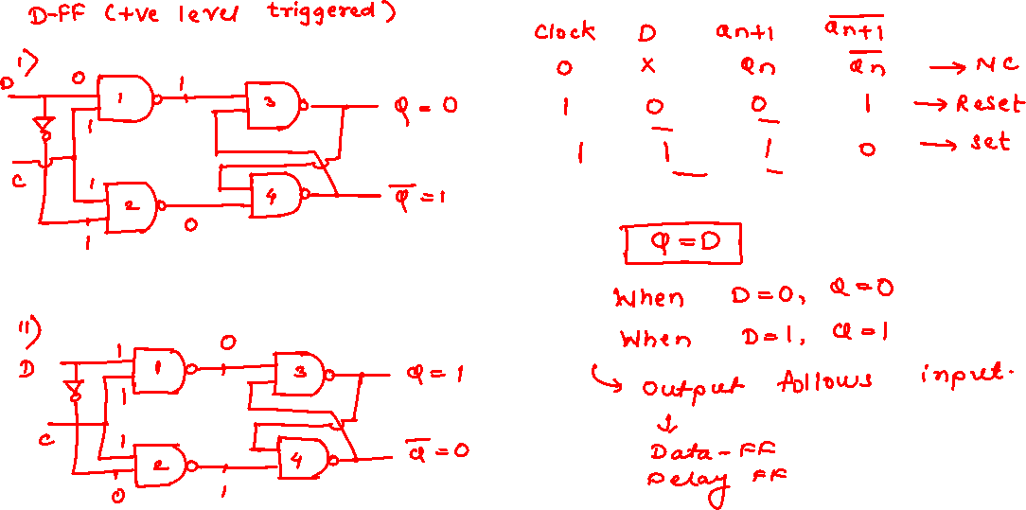

Slide 21
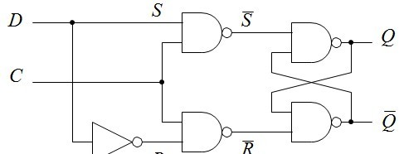
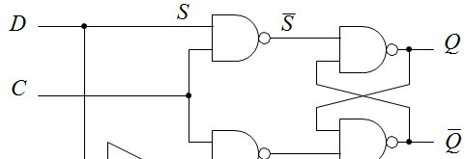
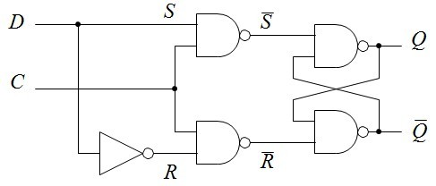
D Flip Flop
0
0
1
X
1
0
1
1
0
1
0
0
1
0
1
1
0
1
1
1
0
1
1
0
1
1
1
0
0
1

Slide 22

D Flip Flop
It acts as a simple memory or ‘latch’.
The previous value stored, Qn, has no effect, unlike other flip-flops. It therefore acts as a simple memory or ‘latch’.
The most widely used flip-flops: simple to build and design with.
A register comprises several D flip-flops, one for each bit to be stored.

Slide 23
Latch and Flip Flop
Latch
Clock input is level sensitive.
Output can change multiple times during a clock cycle.
Output changes while clock is active.
Flip-Flop
Clock input is edge sensitive.
Output can change only once during a clock cycle.
Output changes on clock transition.

Slide 24
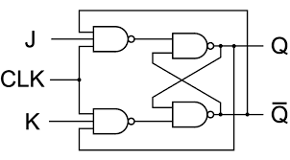
J-K Flip Flop

Slide 25
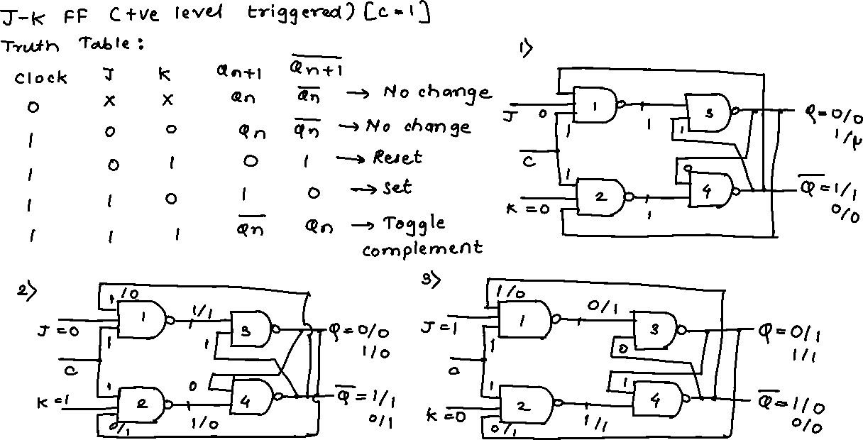

Slide 26
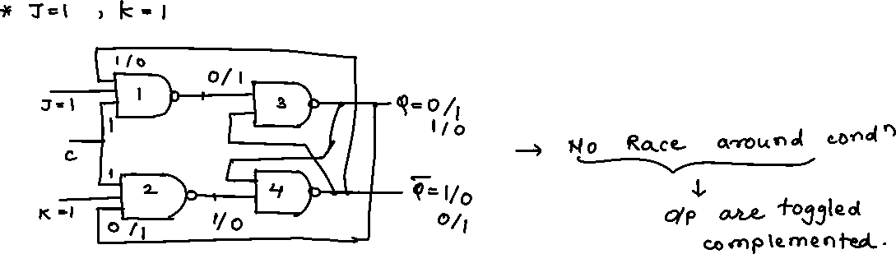


Slide 27


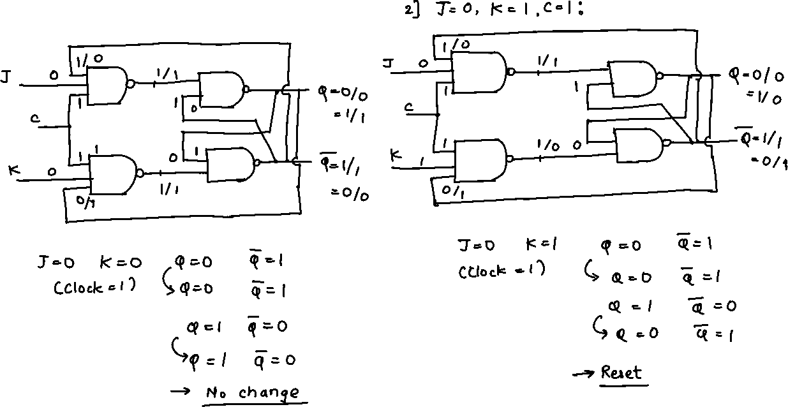

Slide 28
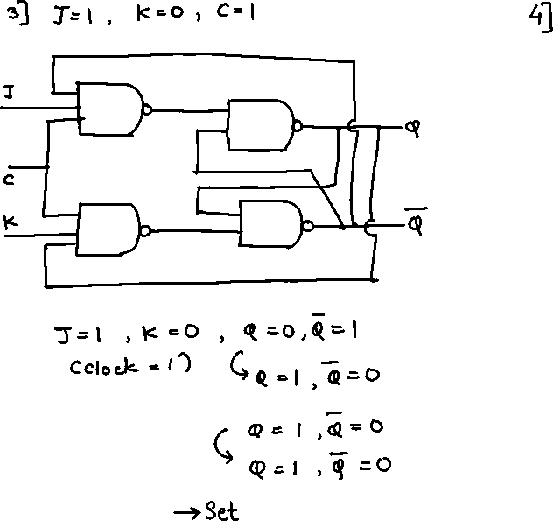
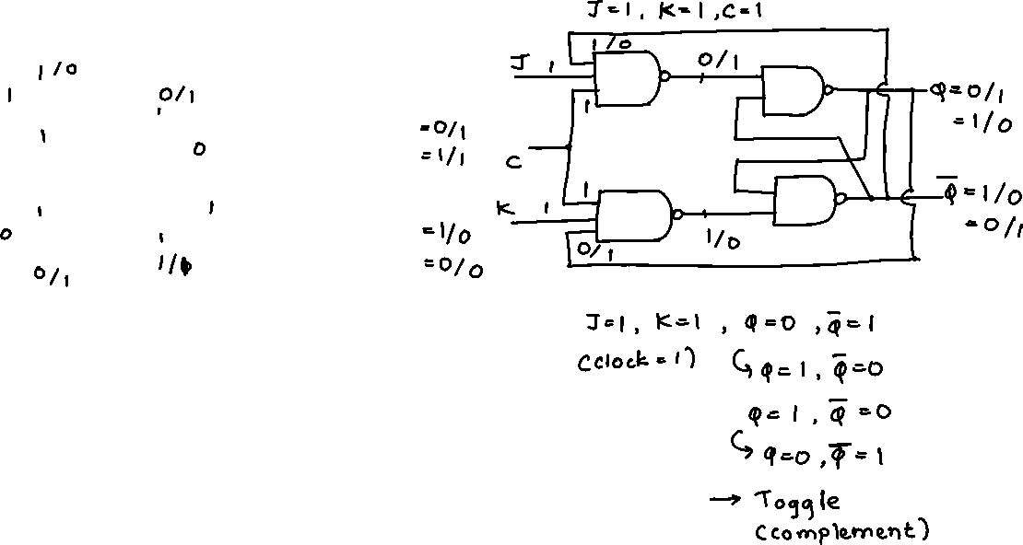

Slide 30
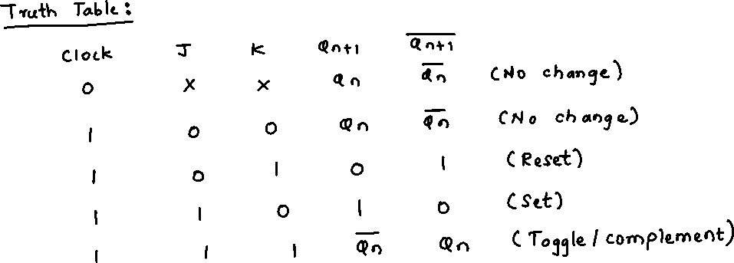

Slide 31
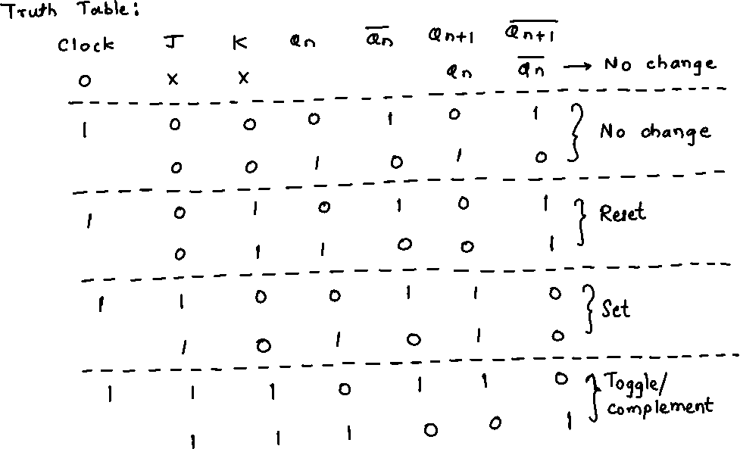


Slide 32
J-K Flip Flop
One of the most useful and versatile flip-flop.
The fundamental difference of this device is the feedback paths to the NAND gates of the input, i.e. Q is NAND with K and CP and Q’ with J and CP.
if the J and K input are both at 1 and clock is applied then the output will change irrespective of its previous condition.
if the J and K input are both at 0 and clock is applied then the output will not change.
No indeterminate condition, in the operation of JK flip-flop.

Slide 33
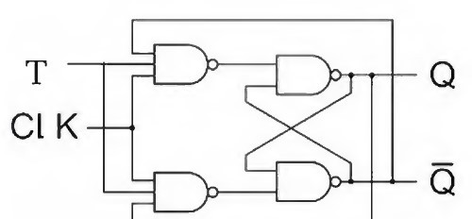



T Flip Flop
C T Q_{n}
^{Q}n+1
0 | X | 0 | 0
 |  | 1 | 1
1 | 0 | 0 | 0
 |  | 1 | 1
1 | 1 | 0 | 1
 |  | 1 | 0
The T flip-flop is a single input version of the JK flip-flop.
The T flip-flop is obtained from the JK type if both inputs are tied together.

Slide 35
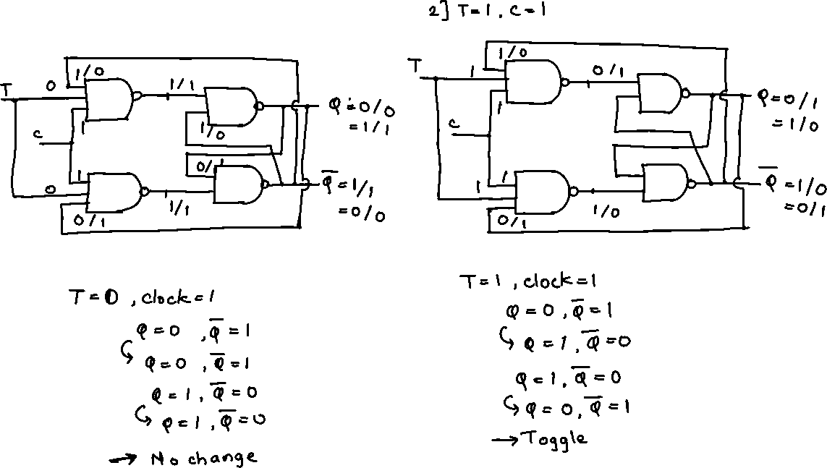

Slide 36
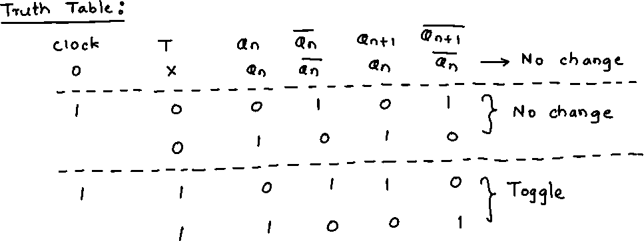
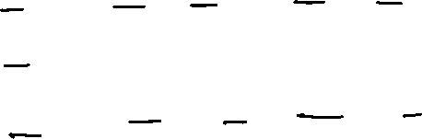

Slide 37
T Flip Flop
The toggle, or T, flip-flop is a bistable device, where the output of the T flip-flop toggles.
Till CP=0, the output is in hold state.
When CP=1, for T=0, previous output is memorized by the circuit. When T=1 along with the clock pulse, the output toggles from the previous value with each clock pulse.

Slide 38
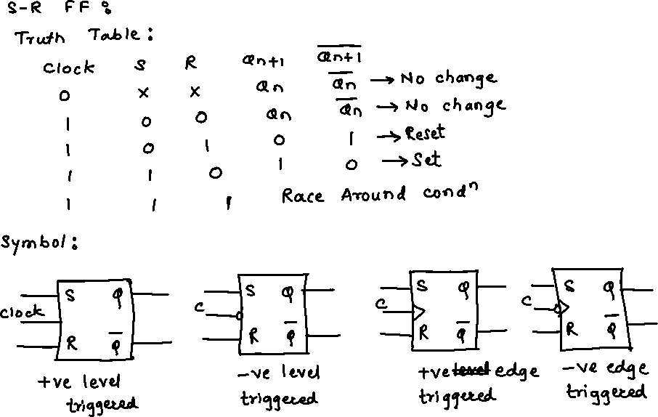

Slide 39
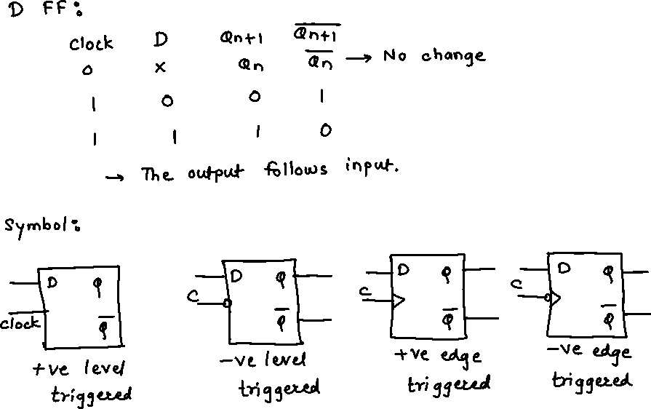

Slide 40
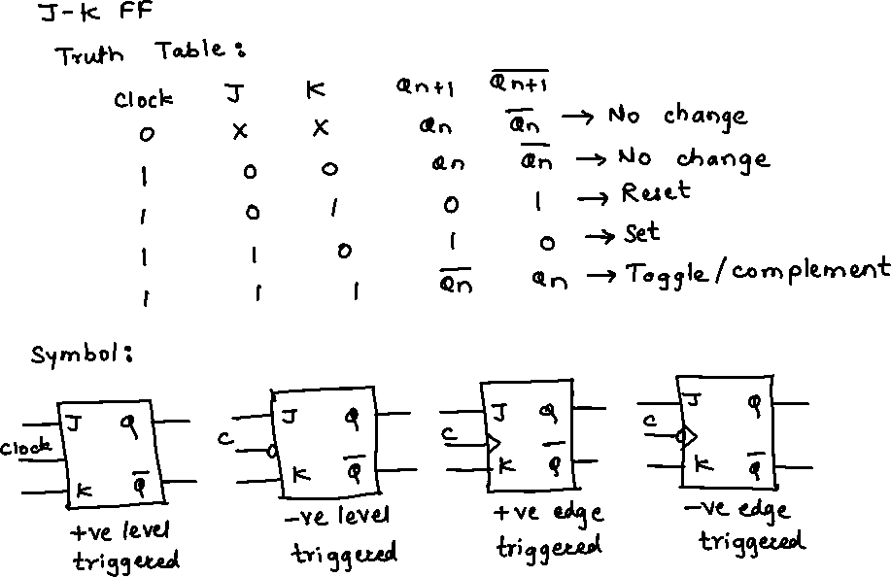

Slide 41
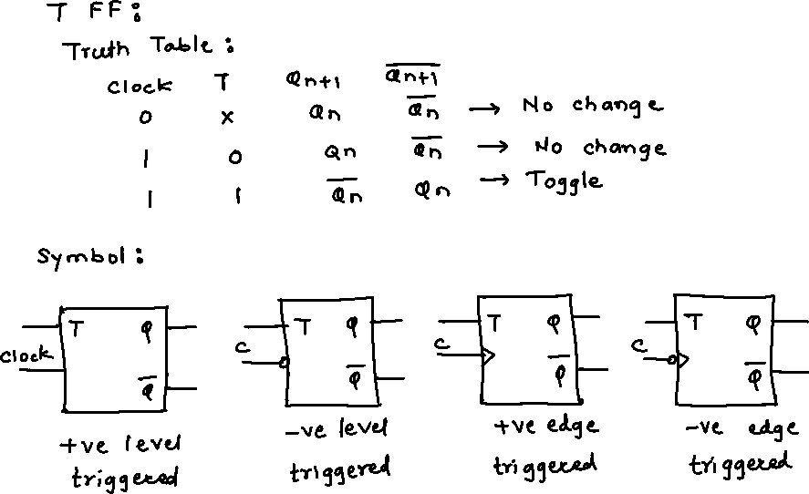

Slide 42
Acknowledgements
Modern Digital Electronics: R P Jain
Web sources

Slide 43
Thank you!

